Slide 1
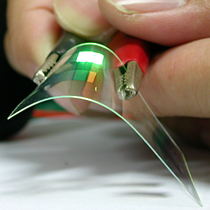
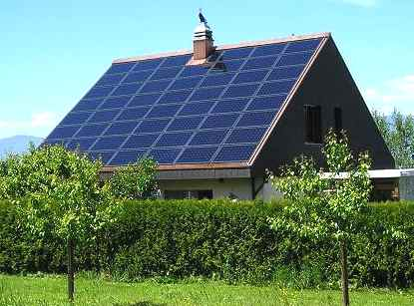
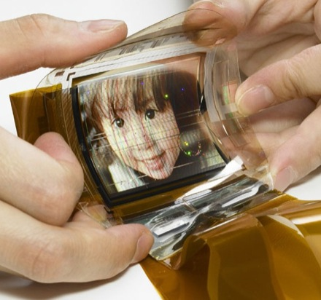
Electrical Science-2 (15B11EC211) Unit-4 Introduction to Semiconductor Lecture-2
Solar Cells
OLED
Technology
Dr. Archana Pandey

Slide 2
Outline of the module
Semiconductor Physics –
Energy Band Model
Carrier Statistics
Intrinsic Semiconductors
Extrinsic Semiconductors
Fermi Level
Charge densities in a semiconductor
Carrier Mobility and Drift Current
Hall Effect
Recombination of charges
Diffusion and conductivity equation

Slide 3
Today we will learn
Classification of semiconductors
Direct and indirect band gap
Intrinsic Semiconductors
Extrinsic Semiconductors
N-type material- Donation of electrons
P-type material- Acceptance of electrons

Slide 4
Direct and Indirect band gap semiconductor
This can be understood from the band picture of the semiconductor.
Semiconductors have a filled valence band and an empty conduction band.
Electrons from the valence band can be excited to the conduction band by either thermal excitation or by optical absorption.
When the electron returns to the valence band the energy is released either as heat or as photons.
In direct band gap semiconductors the dominant mechanism by which the energy is released (in the absence of defects) is by photons (electromagnetic radiation)
While in indirect band gap semiconductors the energy is released by phonons (heat).
Ref 1, 2

Slide 5
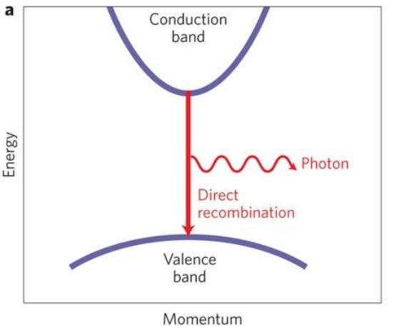
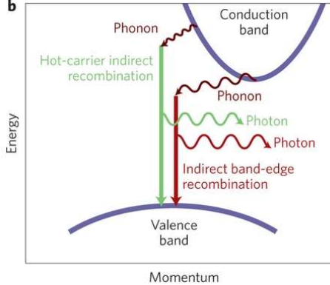
Direct and Indirect band gap semiconductor…
Ref 1, 2

Slide 6
Direct Band Gap Semiconductors-
For these semiconductors, conduction band minima and valence band maxima occurs at same value of momentum.
An e- from CB directly return to VB without changing it’s momentum and releases energy in the form of light (photon hv).
Example: GaAS, GaAsP
For these semiconductors, conduction band minima and valence band maxima occurs at different value of momentum.
When e- from CB returns VB after changing its momentum is called indirect band gap semiconductors.
E- changes its momentum by releasing phonon which is a heat particle.
Example: Si, Ge
Indirect Band Gap Semiconductors-
Ref 1, 2

Slide 7
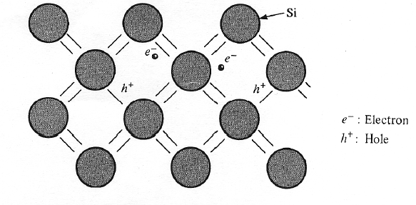
Intrinsic Semiconductor
A perfect semiconductor crystal with no impurities or lattice defects is called an intrinsic semiconductor.
At T=0 K
No charge carriers, Valence band is filled with electrons, Conduction band is empty
At T>0
Electron-hole pairs are generated,
EHPs are the only charge carriers in intrinsic material
Since electron and holes are created in pairs – the electron concentration in conduction band, n (electron/cm³) is equal to the concentration of holes in the valence band, p (holes/cm³).
Each of these intrinsic carrier concentrations is denoted n_{i.}
Thus for intrinsic materials n=p=n_{i}
Electron-hole pairs in the covalent bonding model in the Si crystal.
Ref 1, 2

Slide 8
Intrinsic Semiconductor…
At a given temperature there is a certain concentration of electron-hole pairs n_{i}.
If a steady state carrier concentration is maintained, there must be recombination of EHPs at the same rate at which they are generated.
Recombination occurs when an electron in the conduction band makes a transition to an empty state (hole) in the valence band, thus annihilating the pair.
If we denote the generation rate of EHPs as g_{i} (EHP/cm³·s) and the recombination rate as r_{i}, equilibrium requires that
r_{i} = g_{i}
Each of these rates is temperature dependent.
For example, g_{i}(T) increases when the temperature is raised, and a new carrier concentration n_{i} is established such that the higher recombination rate r_{i} (T) just balances generation.
Ref 1, 2

Slide 9
Intrinsic Semiconductor…
At any temperature, we can predict that the rate of recombination of electrons and holes r_{i}, is proportional to the equilibrium concentration of electrons n₀ and the concentration of holes p₀
r_{i} = α_{r} n₀ p₀ = α_{r} n_{i}² = g_{i}
The factor α_{r} is a constant of proportionality which depends on the particular mechanism by which recombination takes place.
Ref 1, 2

Slide 10
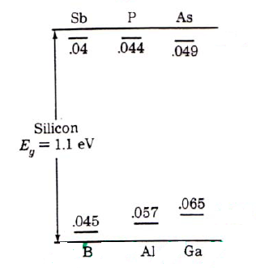
Extrinsic Semiconductor…
By doping, a crystal can be altered so that it has a predominance of either electrons or holes.
Thus there are two types of doped semiconductors, n-type (mostly electrons) and p-type (mostly holes).
When a crystal is doped such that the equilibrium carrier concentrations n₀ and p_{o} are different from the intrinsic carrier concentration n_{i}, the material is said to be extrinsic.
When impurities or lattice defects are introduced, additional levels are created in the energy bands structure, usually within the band gap.
Donor impurities (elements of group V): P, Sb, As
Acceptor elements (group III): B, Al, Ga, In
Total number of electrons
III – Al – 13
IV – Si – 14
V - P - 15
The valence and conduction bands of silicon with additional impurity energy levels within the energy gap.
Ref 1, 2

Slide 11
Extrinsic Semiconductor – donation of electrons
n-type material
An impurity from column V (Vth group Phospurs, Arsenic, Antimony) introduces an energy level very near the conduction band in Ge or Si.
This level is filled with electrons at 0 K, and very little thermal energy is required to excite these electrons to the conduction band.
Thus, at about 50-100 K nearly all of the electrons in the impurity level are "donated" to the conduction band (It is called free e-.)
Such an impurity level is called a donor level, and the column V impurities in Ge or Si are called donor impurities.
According to law of Nutrality n_{n} =p_{n}+n_{D}
Mass action law n_{n}*p_{n}=ni²
Majority carriers are electrons and minority carriers are holes
Donation of electrons from a donor level to the conduction band
Ref 1, 2

Slide 12
Extrinsic Semiconductor…
From figure we note that the material doped with donor impurities can have a considerable concentration of electrons in the conduction band, even when the temperature is too low for the intrinsic EHP concentration to be appreciable.
Thus semiconductors doped with a significant number of donor atoms will have n₀>>(n_{i},p₀) at room temperature. This is n-type material.
Ref 1, 2

Slide 13
Extrinsic Material – acceptance of electrons
Atoms from column III (B, Al, Ga, and In) introduce impurity levels in Ge or Si near the valence band.
These levels are empty of electrons at 0 K.
At low temperatures, enough thermal energy is available to excite electrons from the valence band into the impurity level, leaving behind holes in the valence band.
Since this type of impurity level "accepts" electrons from the valence band, it is called an acceptor level, and the column III impurities are acceptor impurities in Ge and Si.
As figure indicates, doping with acceptor impurities can create a semiconductor with a hole concentration p₀ much greater than the conduction band electron concentration n₀ (this is p-type material).
According to law of Nutrality n_{p} +n_{A}=p_{p}
Mass action law n_{p}*p_{p}=ni²
Majority carriers are holes and minority carriers are electrons
P-type material
Acceptance of valence band electrons by an acceptor level, and the resulting creation of holes.
Ref 1, 2

Slide 14
Donor and acceptors in covalent bonding model
In the covalent bonding model, donor and acceptor atoms can be visualized as shown in the Figure.
An Sb atom (column V) in the Si lattice has the four necessary valence electrons to complete the covalent bonds with the neighboring Si atoms, plus one extra electron.
This fifth electron does not fit into the bonding structure of the lattice and is therefore loosely bound to the Sb atom.
A small amount of thermal energy enables this extra electron to overcome its coulombic binding to the impurity atom and be donated to the lattice as a whole.
Thus it is free to participate in current conduction. This process is a qualitative model of the excitation of electrons out of a donor level and into the conduction band.
Donor and acceptor atoms in the covalent bonding model of a Si crystal.
Ref 1, 2

Slide 15
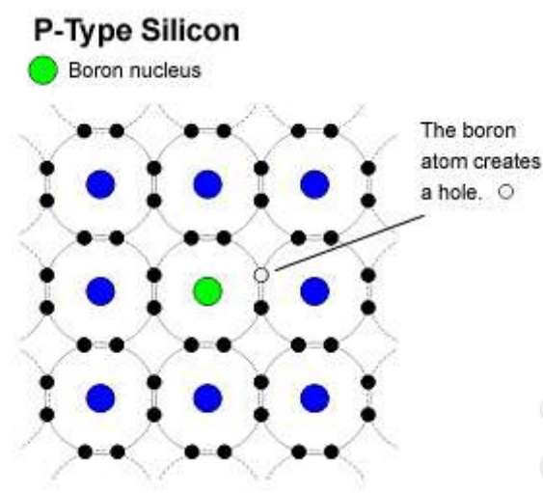
Donor and acceptors in covalent bonding model…
Similarly, the column III impurity Boron has only three valence electrons to contribute to the covalent bonding, thereby leaving one bond incomplete.
With a small amount of thermal energy, this incomplete bond can be transferred to other atoms as the bonding electrons exchange positions.
Ref 1, 2

Slide 16
Problems
Problem 1- Consider a region of Si at room temperature. For each of the following cases, calculate the equilibrium electron and hole concentrations (n and p). Assume that the dopants are fully ionized.
a) N_{D} = 1.00 ×10¹⁷ cm⁻³ , N_{A} = 0
b) N_{D} = 0, N_{A} = 1.00 ×10¹³ cm⁻³

Slide 17
Solution-
The donor density is 1000 times the intrinsic density.
All of the donor electrons will go in the conduction band, overwhelming the number of intrinsic carriers that were there.
So we expect n ≈ N_{D} = 1.00 ×10¹³ cm⁻³
We would determine the hole density from np = ni² ,
so p = ni² / n ≈ ni²/N_{D} =
10²⁰ /10¹³ = 1.00 ×10⁷ cm-3
Note that doping the semiconductor n-type means that we now have more electrons in the conduction band, and we have fewer holes in the valence band than for the intrinsic semiconductor.
(b) The donor density is 10⁷ times the intrinsic density.
All of the donor electrons will go in the conduction band, overwhelming the number of intrinsic carriers that were there.
So we expect expect p ≈ N_{A} = 1.00 ×10¹⁷ cm⁻³
We would determine the electron density from np = ni² ,
so n= ni² / p ≈ ni²/N_{A}=
10²⁰ /10¹⁷ = 1.00 ×10³ cm-3
Note that doping the semiconductor p-type means that we now have more holes and we have fewer electrons than the intrinsic semiconductor.

Slide 18
References
Streetman, Ben G., and Sanjay Banerjee. Solid state electronic devices. Vol. 4. Englewood Cliffs, NJ: Prentice hall, 1995.
Sze and Ng," Physics of Semiconductor Devices", 3rd Ed., 2006

